Slide 2
Developing Data Intervention in your school
Julia Upton UP@king-ed.suffolk.sch.uk

Slide 3
Three data stages
Reflective Data
Current Data
Intervention
Notes:
Three stages
Whole school data – what do we have and what does it mean?
Real time data - within school tracking systems – how effective are they and do they help us to make improvements?

Slide 4
Getting started
Love it
Loathe it
Notes:
Fears of data?
Comfortable about data?

Slide 5
Data – the root of all evil?
Figures v Real students
Benchmark v Progress
Analysis v Action
Notes:
Impersonal – not about individuals , seem like we are talking about something which doesn’t involve people
How do we benchmark? Consistent across the school? Meaningful, challenging, reaslistic?
Us and ALPS – minimum target grade.
FFT B or D?
The language we use – estimated/predicted/current/projected/target
Learnt from Ofsted?
Balance how much time we spend analysing and putting into place things that will make a difference

Slide 6
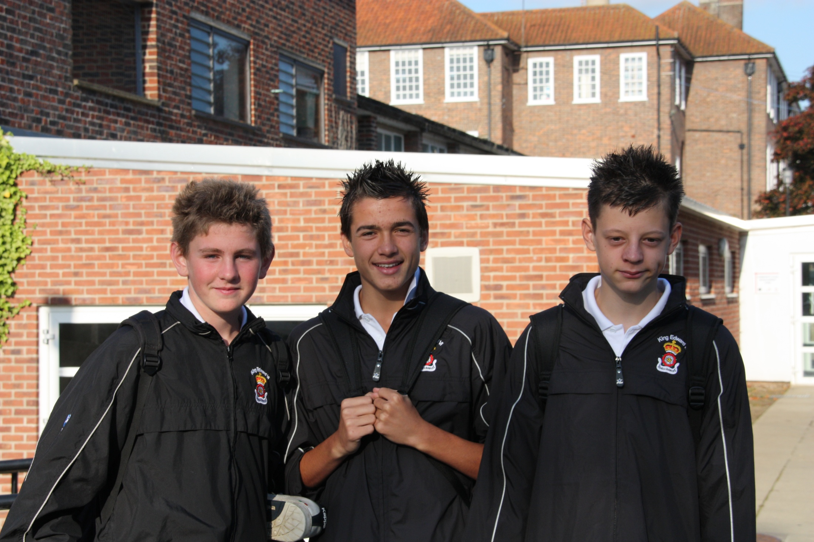

Slide 7
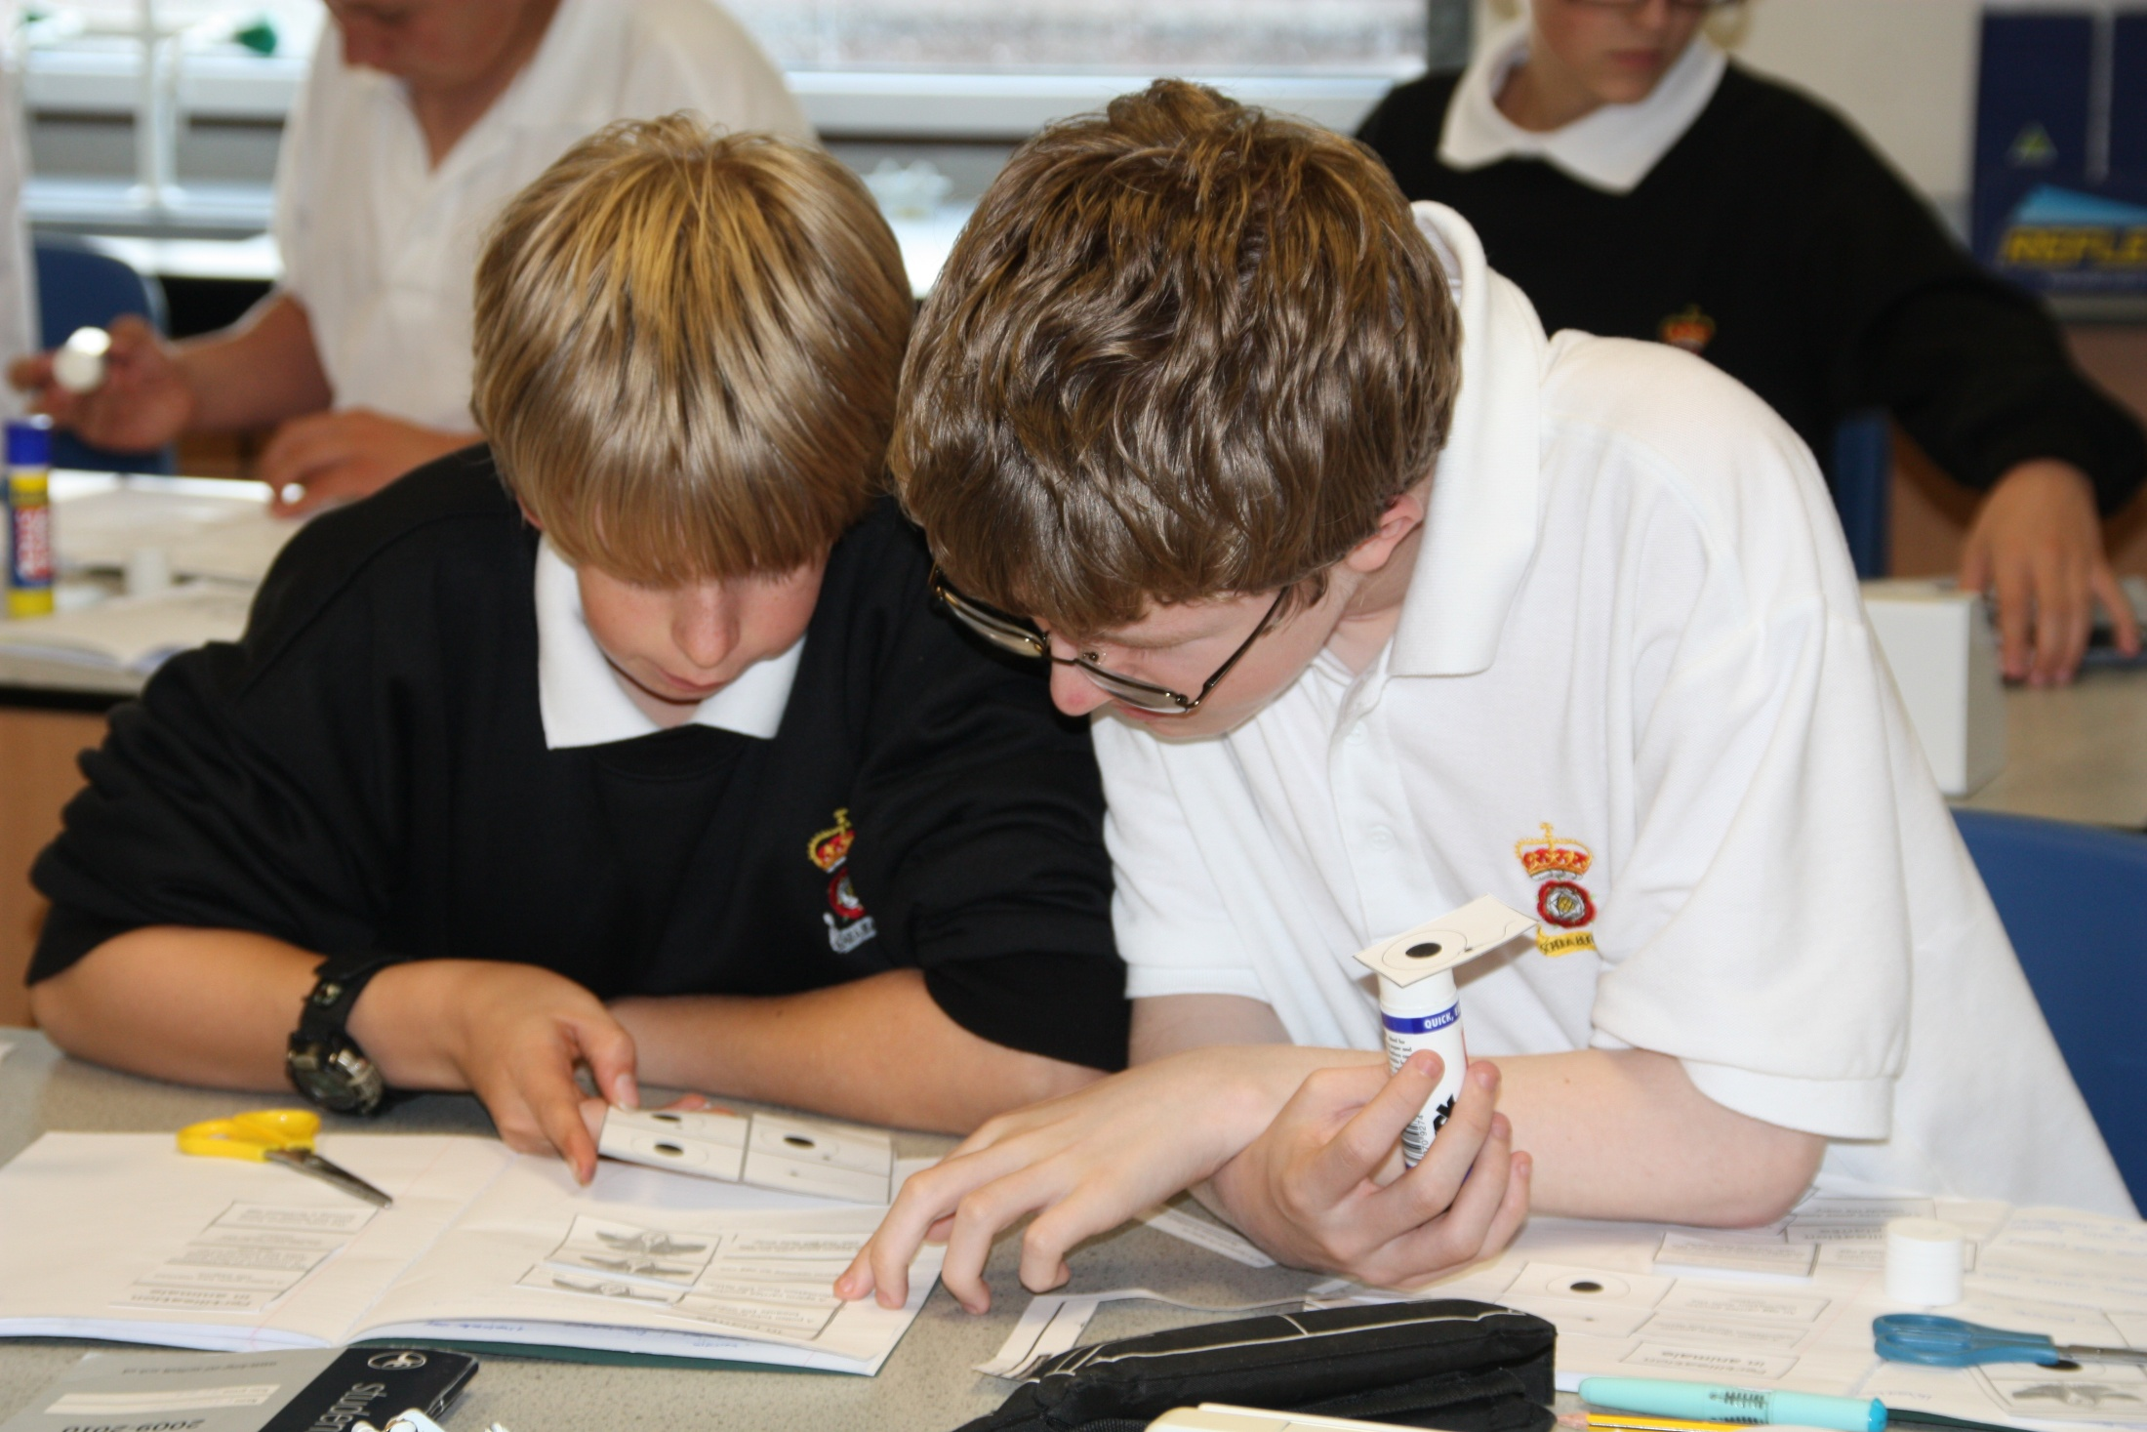

Slide 8
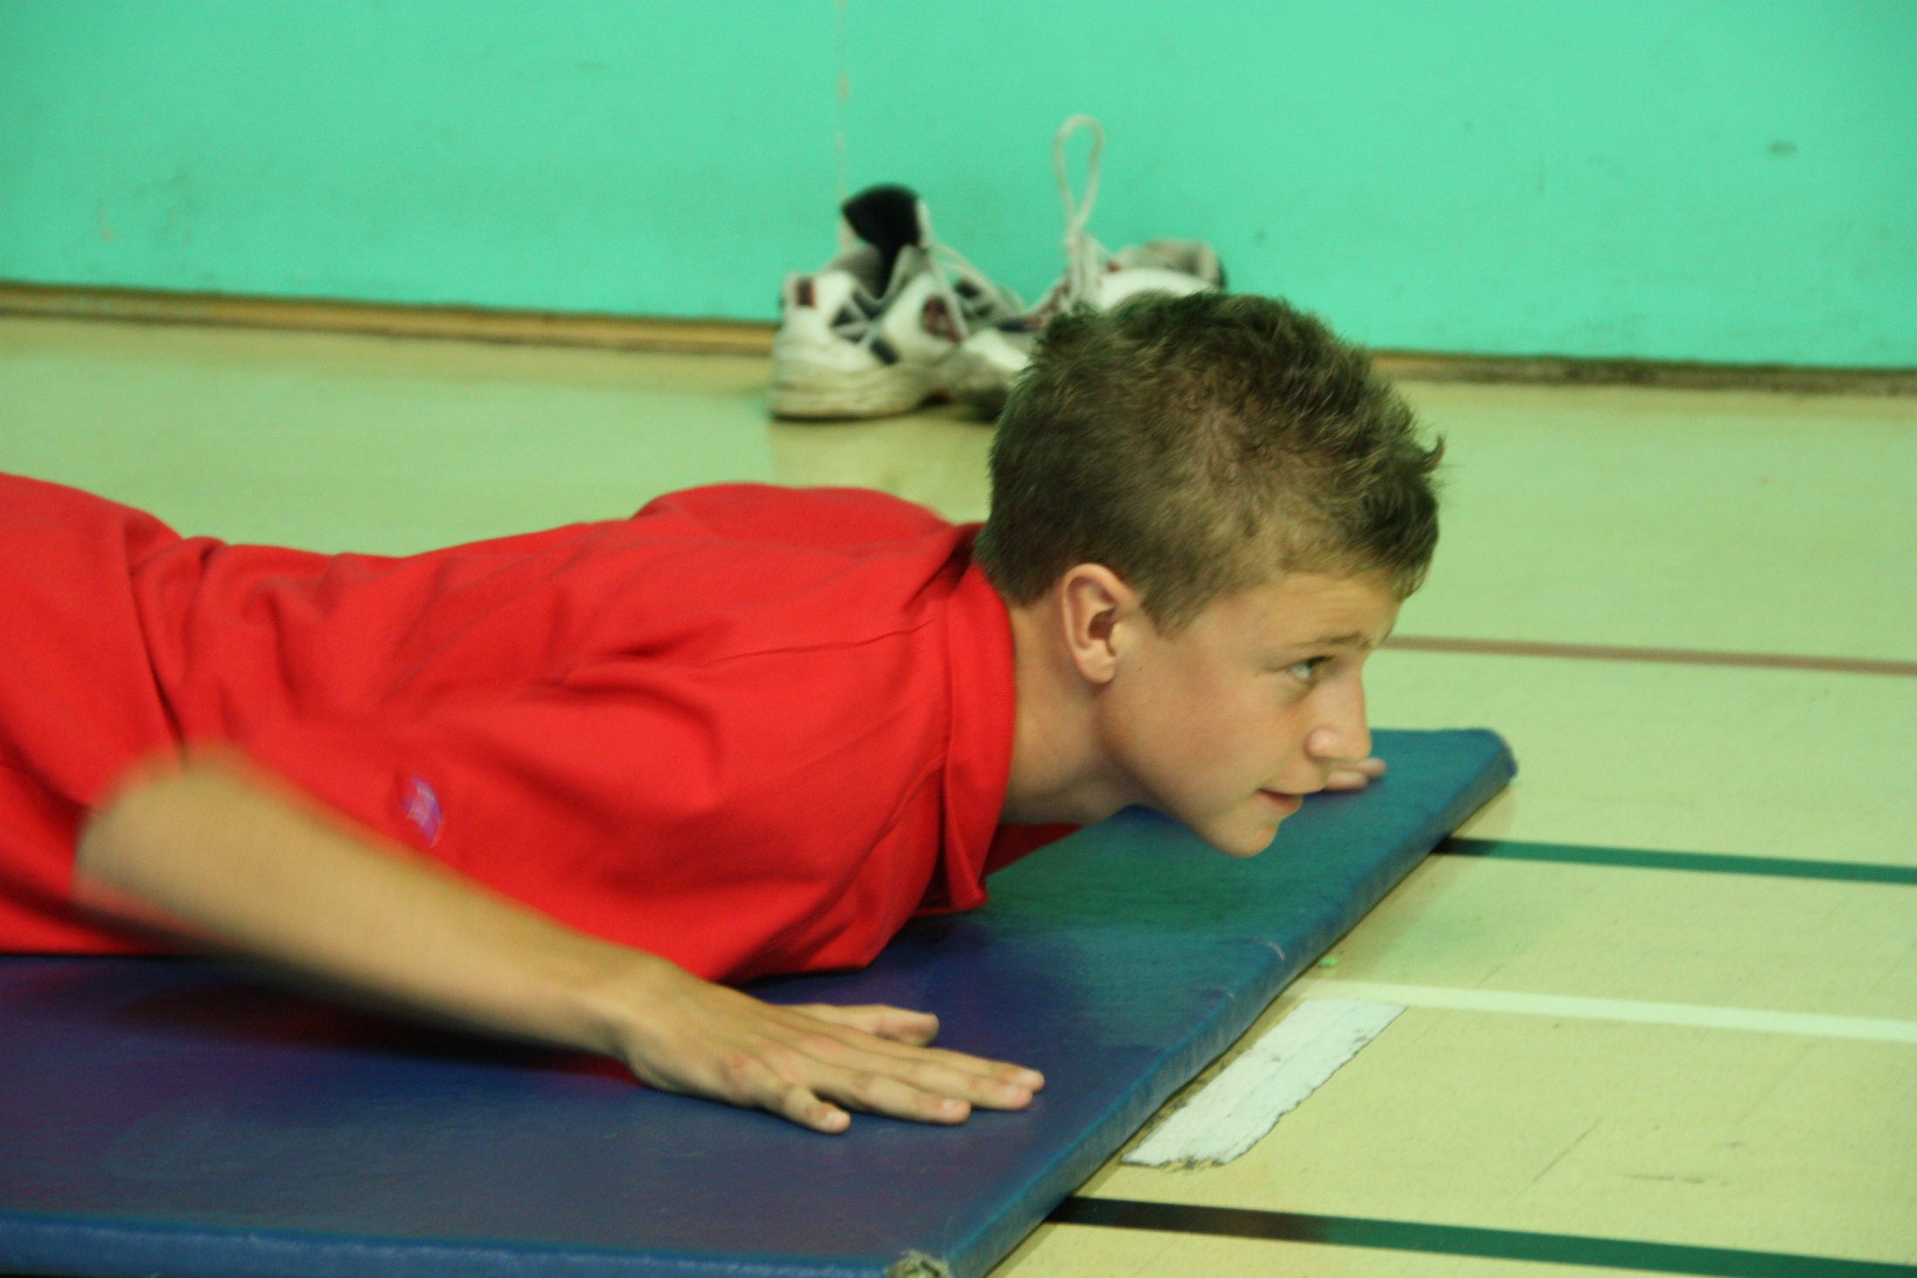

Slide 10
Whole school – what do we have?
Raise-Online, 4Matrix
FFT – KS3, 4 and 5
County and National Residuals
Post 16 – LAT, ALPS, PANDA

Slide 11
A*C
A*A
Estimates and actual grade distribution - Mathematics
35.%
30.%
25.%
20.%
ACT
15.%
KS43
10.%
5.%
0.%
G
F
E
D
C
B
A
A*
Notes:
FFT v. actual grades – what does it mean we want to do in Maths?

Slide 12
What does this tell you?
If you were Ofsted what would you want to go and test out?
Is it about cohorts or subjects?
What would you focus on for improvement?
Notes:
What do you think the issues are? – A3 sheet

Slide 13
A*C
A*A
Estimates and actual grade distribution - Science
35.%
30.%
25.%
20.%
ACT
15.%
KS43
10.%
5.%
0.%
G
F
E
D
C
B
A
A*
Notes:
Focus on the top end? Poor teaching of lower groups? Staffing inexperienced? Best on top sets and A level? Course right?

Slide 14
Reflection ↔ Impact
Benchmark
Reflection
Change

Slide 15
How are you doing?
What % A*-C will you get this year?
Do you know how ALL students are doing in ALL subject areas? How?
Is assessment consistent within teams? Across the school?
Today? March?
Notes:
Cohorts of students? Who to intervene with?
What tracking systems?
What moderation/standardisation?

Slide 16
Data that is “live”
Current student performance data
Accessible
Fresh
Used by subject/pastoral leaders
Used with students/parents
Year 11 2010
Year 10 2010
Notes:
How are humanities doing?

Slide 21
How do subjects track and monitor?
Do they know their target?
Do their know their current grade?
Do they know what to do to improve?

Slide 22
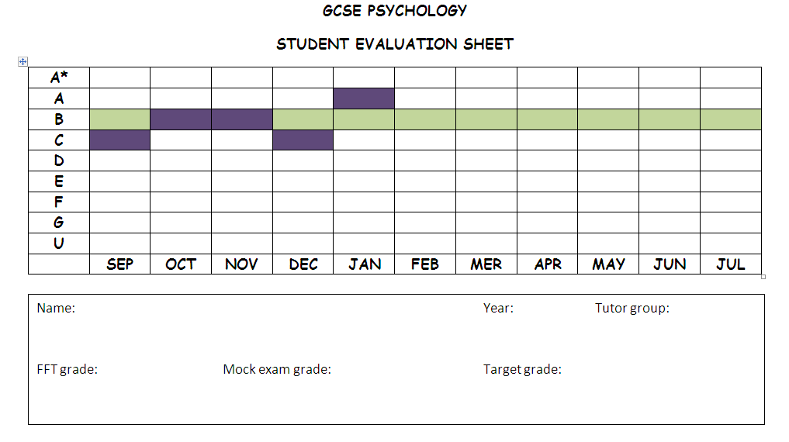

Slide 23
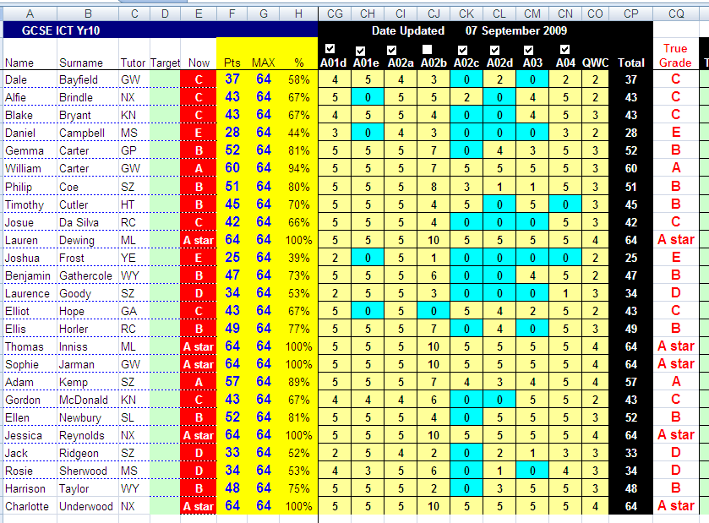

Slide 24
Mentoring Systems
Julia Upton UP@king-ed.suffolk.sch.uk

Slide 25
Intervention
Julia Upton UP@king-ed.suffolk.sch.uk
Notes:
Easter revision sessions for targeted students – maths staff paid or day off in lieu
Sixth form mentors, HLTA, extra staff member – support outside the classroom, been in a class of 30 for 5 years and still doesn’t get it, needs smaller group, opportunity to ask more detail and time
Sixth form students – those doing AS maths and those who got C grades
Don’t look to always get lower class sizes, 6 sets and 1 member of staff for withdrawal allow you to target students, the argument that the smaller the group the better the attainment doesn’t wash from 30 to 26. But from 30 to group of 5 it does.

Slide 26
Sixth Form Maths Leaders
Break down your explanation
Get them to explain what they are doing
What operation
Take things slowly
What step did you lose them?
PRAISE, PRAISE, PRAISE
Different ways of explaining what to do
Avoid “tricks” and short cuts
Build up their proportional reasoning at all times
Notes:
Ten top tips for supporting others in maths
Make sure you break down your explanation of what to do – use key steps.
Get them to explain what they are doing to reach an answer – key steps. DON’T just accept their answer even if it is correct.
Make them think about what operation is appropriate and why. When to divide and which way around and when to multiply will be the hardest links.
Take things slowly – just because one of the students explains it correctly and the others nod in agreement don’t assume that they all know what to do.
If they get stuck think about what step you lost them. Repeat the skill step by step and get them to say at what point they get stuck.
PRAISE, PRAISE, PRAISE when they can explain what they have done and get it right. When you get Maths wrong it saps your confidence.
You are not there to show off how good you are at Maths but use the way you learnt how to do things to help them. They will ask what grade you got at GCSE.
Think about different ways of explaining what to do. It may be that the way you do it works for you but not for them. Think about
Avoid “tricks” and short cuts that only work for a particular type of question.
Build up their proportional reasoning at all times – you know that 45/360 degrees in a circle means “45 out of 360” and hence you can convert to a percentage or out of 200 people with ease. Build up these links with them wherever possible.

